Slide 1
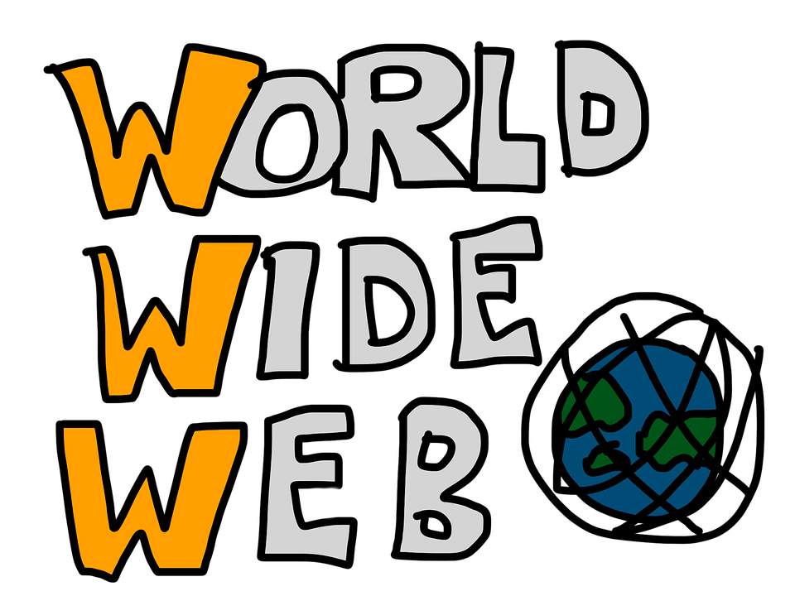
The Internet

Slide 2
The Internet and the Web
The Internet is a network of networks. It’s a Wide Area Network which connects devices and networks.
The World Wide Web (www) is a collection of websites that are hosted on web servers and accessed through the http protocol.
The Internet and the WWW are not the same. The Internet is the network behind the www but it also has many other uses such as email and instant messaging.

Slide 3
How the web works
What happens when you view a webpage in a web browser on a computer or phone?

Slide 4
Clients and Servers
Computers connected to the web are called clients and servers.
Clients are the typical web user’s internet connected devices (eg your computer connected to your wifi, or your phone connected to your mobile network) and web-accessing software available on those devices (Chrome, firefox).
Servers are computers that store web pages, sites or apps. When a client device wants to access a webpage, a copy of the webpage is downloaded from the server onto the client machine to be displayed in the user’s web browser.

Slide 5
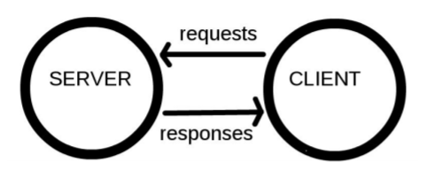

Slide 6
The other parts
The client and server don’t tell the whole story. There are many other parts involved.
Imagine the web is a road. On one end of the road is the client, which is like your house. On the other end of the road is the server, which is a shop you want to buy something from.

Slide 7
Internet Connection
Allows you to send and receive data on the web.
It’s the street between your house and the shop.

Slide 8
TCP/IP
Transmission Control Protocol and Internet Protocol are communication protocols that define how data should travel across the web.
This is like the transport mechanisms that let you place an order, go to the shop, and buy your goods. For example, a car or bike.

Slide 9
TCP/IP
TCP/IP is a suite or set of protocols arranged in four layers. Data to be transmitted (or when it is received) must pass through the layers where packaging data is added or read.
The four layers are:
Application Layer
Transport Layer
Internet Layer
Data Link Layer
Note: More on this in Computer Network Protocol notes

Slide 10
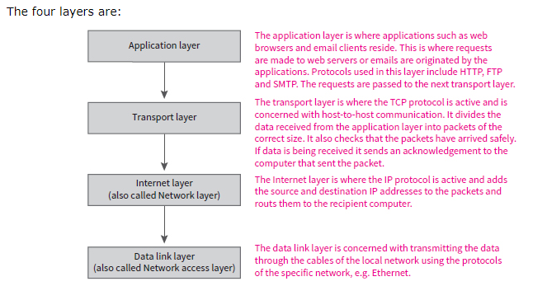
TCP/IP

Slide 11
DNS
Domain Name Servers are like an address book for websites. When you type a web address in your browser, the browser looks at the DNS to find the website’s real address before it can retrieve the website. The browser needs to find out which server the website lives on so it can send HTTP messages to the right place.
This is like looking up the address to the shop so you can access it.

Slide 12
HTTP
Hypertext Transfer Protocol is an application protocol that defines a language for clients and servers to speak to each other.
This is like the language you use to order your goods.

Slide 13
Component Files
A website is made up of many different files, which are like the different parts of the goods you buy from the shop. These files come in two main types:
Code files: Websites are built primarily from HTML, CSS and JavaScript
Assets: This is a collective name for all the other stuff that makes up a website such as images, music, video, pdf’s, documents.

Slide 14
What happens?
When you type a web address into your browser (walking to the shop):
The browser goes to the DNS server and finds the real address of the server that the website lives on.
The browser sends a HTTP request message to the server, asking it to send a copy of the website to the client (you go to shop and order goods). This message and all other data sent between the client and server is sent across your internet connection using TCP/IP.

Slide 15
What happens?
3. If the server approves the client’s request, the server sends the client a “200 OK” message, which means “You can look at the website, here it is” and then starts sending the websites files to the browser as a series of small chunks called data packets (the shop gives you your goods and you bring them home)
4. The browser assembles the small chunks into a complete website and displays it to you.

Slide 16
DNS explained
Real web addresses aren’t the nice, memorable strings you type into your address bar. They are special numbers such as 63.245.215.20
This is called an IP address and it represents a unique location on the web. However it is not easy to remember. That is why Domain Name Servers were invented. These are special servers that match up a web address you type into your browser to the websites IP address.
You can find the IP address of a website by typing its domain into a tool like IP checker.

Slide 17
Packets
We used the term packets to describe the format in which the data is sent from server to client.
When data is sent across the web, it is sent as thousands of small chunks so that many different web users can download the same website at the same time.
If websites are sent as single big chunks, only one user could download at one time which would make the web inefficient and not much fun to use.

Slide 18
HTML
Hypertext Markup Language is the standard markup for creating Web pages.
It is not a programming language, it is a markup language used to tell your browser how to structure the web pages you visit.

Slide 19
HTML stands for Hyper Text Markup Language
HTML describes the structure of Web pages using markup
HTML elements are the building blocks of HTML pages
HTML elements are represented by tags
HTML tags label pieces of content such as heading, paragraph, table etc
Browsers do not display the HTML tags but use them to render the content of the page.

Slide 20
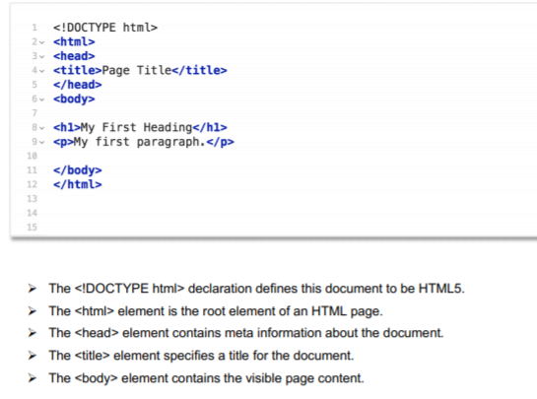
Structure of a HTML Document

Slide 21
Web Browsers
The purpose of a web browser (Chrome, Safari, Firefox) is to read HTML documents and display them.
The browser does not display the HTML tags but uses them to determine how to display the document.

Slide 22
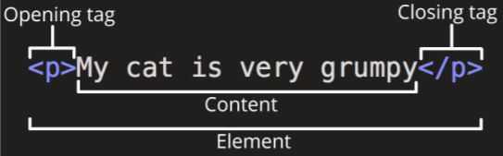
HTML Tags
HTML tags are element names surrounded by angled brackets.

Slide 23
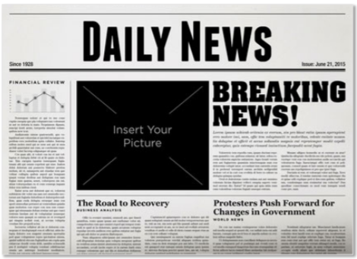
Page Structure
Most structured text consists of headings and paragraphs, whether you are reading a story, magazine, newspaper or a textbook.

Slide 24
Page Structure
Users looking a web page tend to scan quickly to find relevant content, often just reading headings. If they can’t see anything useful within a few seconds, they’ll go somewhere else.
Search engines indexing your page consider the contents of headings as important keywords for influencing the page’s search rankings. Without headings, your page will perform poorly in terms of Search Engine Optimisation (SEO).

Slide 25
Page Structure
Visually impaired people often don’t read web pages, they listen to them instead with software called a screen reader. This software provides ways to get fast access to given text content. Among techniques used, they provide an outline of the document by reading out headings allowing their user to find information quickly. If headings are not available, they will be have to listen to the whole document.
To style content with CSS or make it do interesting things with JavaScript, you need to have elements wrapping the relevant content so CSS/JavaScript can target it.

Slide 26
CSS
Cascading Style Sheets is a language that describes the style of a HTML document.
It describes how HTML elements are to be displayed on screen.

Slide 27
CSS
HTML was never intended to contain tags for formatting a web page. It was created to describe content (h1, p, ul).
When tags like <font> and colour attributes were added to HTML, it started a nightmare for web developers. Development of large websites where fonts and colour information were added to every single page became a long and expensive process.
The World Wide Web Consortium (W3C) created CSS to solve this problem. CSS removed the style formatting from the HTML page.

Slide 28
How does CSS work?
When a browser displays a document, it must combine the documents content with its style information. There are two stages:
The browser converts HTML and CSS into the DOM (Document Object Model). The DOM represents the document in the computer's’ memory. It combines the document’s content with its style.
The browser displays the contents of the DOM.

